Slide 1
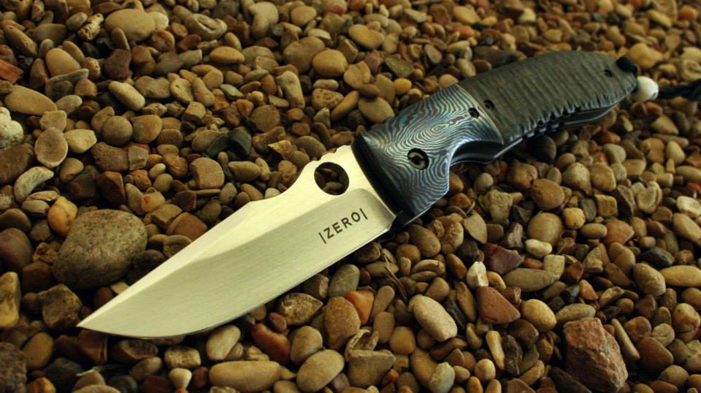
| Z E R O | Fabrication
Andi Dedja
Renan (Ram) Maramba
Seong Paik
David Woodfork

Slide 4
The Problem
Knifemakers need to be in the shop
Parts are the goal: sourcing and engineering eat time
No comprehensive, customer-focused fabrication shops
Existing shops have prohibitive minimums

Slide 5
The idea
Six-step process:
Creation
Engineering
Sourcing
Fitting
Assembling
Finishing
Value chain service company that services steps 2-5

Slide 6
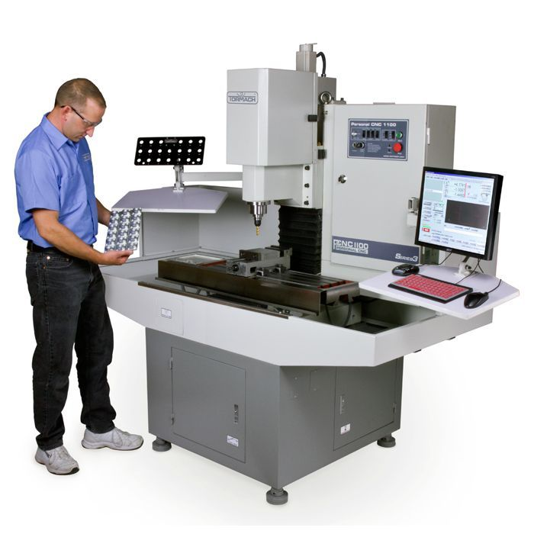

Slide 11
The solution in numbers
70% markup still less than handmade parts
Knifemakers recoup majority of labor hours
More efficient material use

Slide 12
Competition
Five current service houses: two are not full-service, two have prohibitive minimums

Slide 13
Market
Knifemakers: estimated 3000 currently active
Not a volume market: monthly output usually less than three per month
High markups: 200% and above
Backlogs: mid-level makers and above have production issues and have backlogs that quickly extend past a year

Slide 14
Marketing Plan
Interactive, intuitive web portal
Social media: Facebook and Instagram, established knife industry portals
Monthly raffles: medallions, bottle openers, etc. from scrap material
Establish dealer connection for clients
Classic strategies: large presence at knife trade shows
5% off each set with manufacturer mark

Slide 15
Skills Profile
 | Market Experience | HR | Marketing | Project Management | Programming Knowledge | Solid Works Knowledge
Ram Maramba | X |  | X | X
Andi Dedja |  | X |  | X
Seong Paik |  | X
David Woodfork |  |  | X
Operator |  |  |  |  | O
Engineer |  |  |  |  |  | O

Slide 16
Timeline

Slide 17
Financial Projections

Slide 18
Sources and Uses

Slide 20
Questions?

