Slide 2
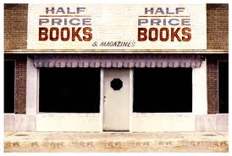
BACKGROUND
First store opened in Dallas, TX in a converted laundromat in 1972
Founders Ken Gjemre and Pat Anderson used their personal books as merchandise
Created off the idea “waste not and read a lot”
America’s largest family-owned new and used book retailer
Launced Half Pint Library project in 1999 which focused on increasing literacy and donating books to non-profit organizations

Slide 3
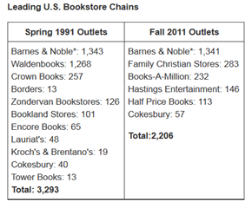
MARKETING STRATEGY
Company
Mission Statement: We buy and sell anything printed or recorded except yesterday's newspaper. Preserving and recycling resources and entertainment of every form is our business.
Customer
More traditional and authentic buying
customers, along with older generations
and high school students.
Competition
Barnes & Noble, Amazon.com, Walmart,
Target, Books-A-Million, Best Buy, and other book stores

Slide 4
MARKETING STRATEGY
Products
new and used books, vinyl records, CDs, DVDs, VHS, comic books, magazines, and gifts
Price
half price off suggested retail or better, on sales books as low as .50, Books by the yard
Promotion
Advertise sales on the radio, send emails to customers, social media
Place
located in 16 states in the US, primarily in Texas and an online market place

Slide 5
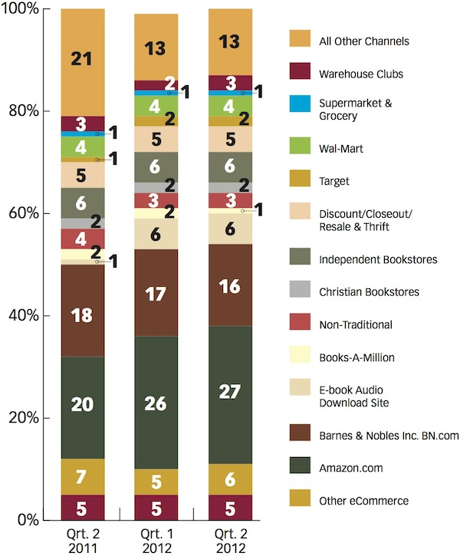
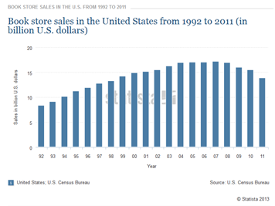
PROBLEM IDENTIFICATION
Printed book sales are losing ground to electronic books
Printed book sales are still rising by
roughly 1% a year, but losing market
share to e-books by 5% a year.

Slide 6
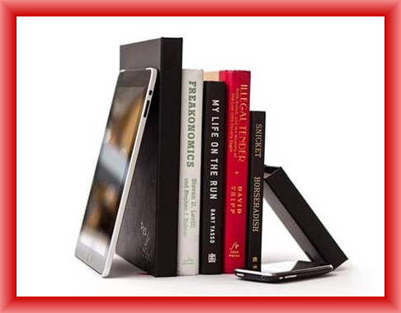
PROBLEM IDENTIFICATION
No proprietary e-reader
Barnes and Noble’s Nook and Amazon’s Kindle have a firm hold on the e-reader market. Borders’ bankruptcy can be attributed to lack of an e-reader.
Internet presence is lagging behind competitors
Amazon’s Marketplace is the standard for
book and media retail.
Fewer locations than competitors
HPB has 110 stores in 16 states; 675 stores
in all 50 states.

Slide 7
Perceptual Map
Mainstream
Target
Best Buy
Walmart
Barnes & Noble
Books-A-Million
Books
Hudson
Amazon.com
Music
Half Price Books
Authentic

Slide 8
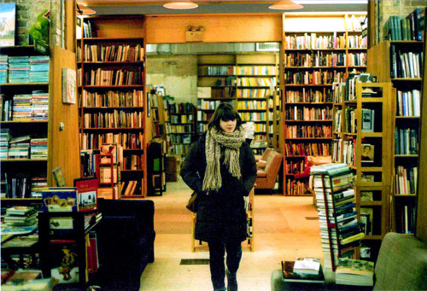
SOLUTION
Change market focus to postmodern, Millennial consumers. Namely, the 35 and under demographic who value authentic, vintage goods such as books, vinyl records, and old magazines.
Unlike previous generations, Millennial’s are unprecedented in size and buying power. According to Forbes:
“But unlike similar groups of the past, the current generation…is a bit more generic in its self-labeling. Why? Because this scene is less focused on one idea, one purpose or one type of music. Instead, today’s hipster is defined by consumption.”
Notes:
Too much writing on this page…maybe keep first sentence and read the rest out loud during the presentation

Slide 9
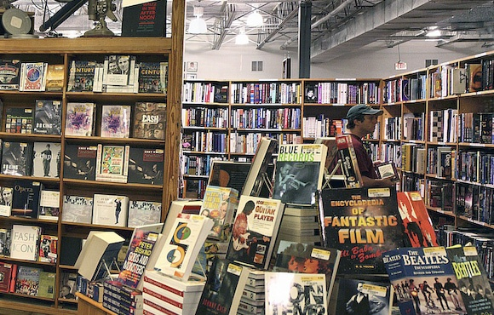
SOLUTION
Distance from e-reader market and glossy retailers such as Barnes and Noble and Amazon.com. The Half Price Books clientele values recycling, reusing, and sharing.
Half Price Books prides itself on its image as a conscious, authentic retailer.
Build more mortar and brick stores in highly populated areas
Notes:
Deleted the shelf and service things since that has nothing to do with solution only describing the HPB policy. Added the brick and mortar thing cause there is something about it in implementation and in problem ID but nothing in solution.

Slide 10
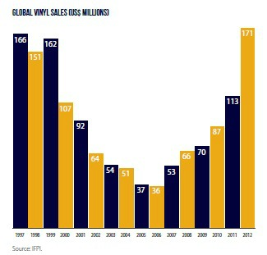
SOLUTION
Focus on being the primary source for both new and vintage vinyl records.
Record sales have risen for five straight years as of 2012, reaching $171 million in sales. Amazon.com alone has seen a 745% increase in vinyl since 2008.
Records sold cater to all different
demographics.
Artists releasing new albums are from
all genres, from Nirvana and Paul
McCartney to Daft Punk and Arcade Fire
Gain market share currently held
by independent record stores.
67% of vinyl record sales came through
independent retailers
Notes:
Leave first sentence then say the rest of it out loud?

Slide 11
IMPLEMENTATION
Partner with local coffee shops and bakeries for in-store food service.
Offer higher-end collectible books.
Open key locations in high populated areas like Nashville and Brooklyn.
Focus radio, TV, and print advertising on HPB’s commitment to vintage/new books and vinyl records.
Aggressively market HPB’s events on National Record Store Day.
Notes:
Need more implementation.
Juxtaposed with Barnes and Noble’s partnership with international coffee chain Starbucks, these smaller partnerships would bolster HPB’s image as a homegrown, local, and authentic retailer.
2. These luxury items will expand the book selection past shelves of required reading paperbacks and pop fiction books.
3. Bolster presence at the flagship location in Dallas. These music hubs will be key in progressing the music image.
4. Already the largest family-owned sellers of new and used books, emphasizing music sales would expand HPB’s image as a dual media source.
5. These events are largely dominated by independent music retailers. HPB has the resources to co-opt the image of these stores and market itself as a leading source for vinyl records.

Slide 12
Questions

